Slide 1
Welcome
Holly Frazier
School District #91, Idaho Falls
Taylorview Middle School
8th Grade Health
33 years teaching. (Retirement 2021)!

Slide 2
SEX Question Protocol
Technique to use when answering all questions. Verbal or written.
Have a Question box available.
Answer all questions if possible, or find the answers.
Medically correct.
No “How to questions”

Slide 3
All Questions
Read question as written.
Validate the student for asking the question.
Identify the type of question?
Answer the factual part of the question, if there is one.
Define any vocabulary and/or replace any slang words.
Answer the question
Encourage student to ask again if you didn’t answer it enough for them.
Refer to or other trusted adult.
Leave the door open.
Notes:
This is a factual question as well as a value question. Demonstrate how to answer it.

Slide 4
Types of Questions
Personal Questions
Technique Questions
Am I normal Questions
What is/fact Questions?
Slang Questions?
Value Questions
  Universal or not?

Slide 5
Personal Questions
If someone was 17 and the other person was 13 and they had sex would it be illegal and could the 17 year old go to jail?
Are LGBT people more likely to get HIV/AIDS?

Slide 6
Technique Questions
How does a condom stay on?
How does one shave their ball sac?

Slide 7
Am I normal questions
My penis is slightly curved is that normal?
Is it possible to have a 3rd nipple?

Slide 8
What is or fact questions
What is a camel toe?
What are the things that hang down by the vagina?

Slide 9
Slang or shock questions
What is the largest human penis?
What is a blow job?

Slide 10
Values questions
Universal:
Is forcing someone to have sex rape?
Non- Universal
I had sex with a female and I am one. Is that a problem?

Slide 11
Universal Values
Large majority of our society holds these values.
We are obligated to teach these values.

Slide 12
Universal Values
Examples
Forcing someone to have sex with you is wrong.
Knowingly spreading disease is wrong.
Elementary school age children should not have sex.
Sex between children and adults is wrong.
Sex with animals is wrong.

Slide 13
Non-Universal Values in the Classroom
There is no large consensus on these issues
It is not helpful or educational to express our own personal beliefs on non-universal issues at school.
Families have the role of teaching values on non-universal issues, not schools.
Schools must teach about these topics in a way that respects the diversity of values.

Slide 14
Non-Universal Values
Examples include . .
Sex outside of marriage
Same-sex relationships
Birth control
Masturbation
Cohabitation
Abortion
What age/under what circumstances it's ok to start having sex

Slide 15
Example and Practice

Slide 16
PRACTICE
Partner up with the person nearest you.
In each pair, pick a “teacher” and an “asker”.
“Teacher” answers the question on the screen.
We’ll discuss as a group.
Then switch roles, “asker” becomes the “teacher”.

Slide 17
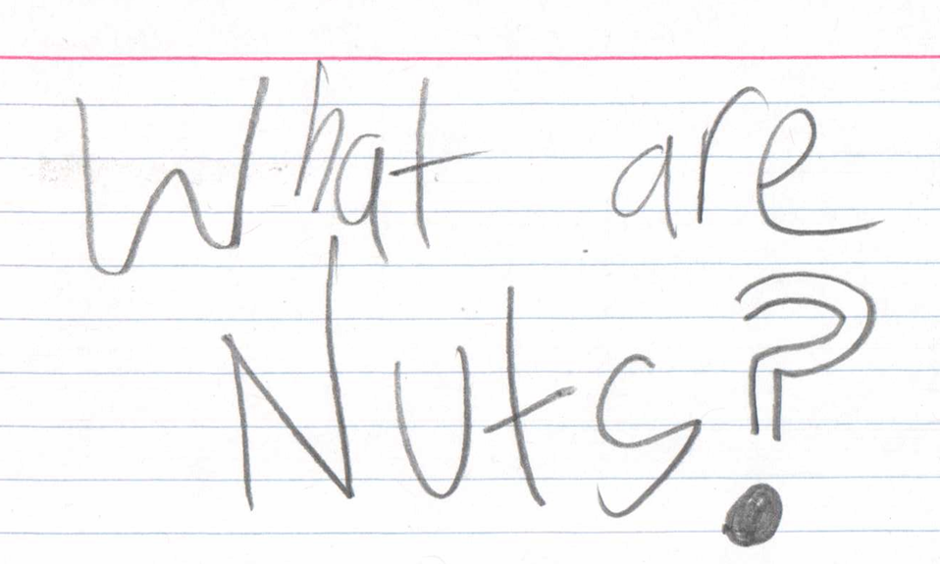
Notes:
What type of question is this?

Slide 18

Notes:
What type of question is this?

Slide 19
Why do guys get hard?
Notes:
Shock question? How would you answer it using the FLASH Protocol?

Slide 20
My penis is only 8 inches is that small?

Slide 21
What is a BJ??

Slide 22
What is a dildo?

Slide 23
Can you die from masturbating?

Slide 24
Questions??
Thank you!

