Slide 1
Every Student Succeeds Act
ESSA Impact on Health and Physical Education

Slide 2

The Long and Winding Road
2002: No Child Left Behind leaves health and physical education behind resulting in funding & program cuts
2002-2015: PEP grant advocacy is ongoing during this time period to retain only access to federal physical education funding
2010: PHYSICAL Act introduced
SHAPE America champions legislation to elevate physical and health education to “core subjects” under federal education law
2015: Every Student Succeeds Act passed!
Health and physical education are included as
part of the definition of a “well-rounded
education” which replaces term “core subjects”
10 Years of Advocacy
for Health and
Physical Education

Slide 3
ESSA Changes the Game
Sets new framework and funding
for elementary and secondary education and shifts focus to a “well-rounded education” for all students

Slide 4
Health & Physical Education in ESSA
Included in well-rounded education
Replaces term “core subjects” from NCLB
Provides access to federal education funding
Title IV, Part A state block grants priority

Slide 5
Well-Rounded Education
English ~ reading/language arts ~ writing ~ science technology ~ engineering ~ mathematics ~ civics and government ~ economics ~ geography ~ foreign languages ~ computer science ~ arts ~ history
career and technical education ~ music
health and physical education.
18 subjects!

Slide 6
ESSA Basics
Government authority – shift to states & school districts
Standards and assessments set by states
Elimination of AYP & HQT – states will set benchmarks and teacher qualifications
Consolidation of programs (like PEP)
Flexibility in funding

Slide 7

Implementation of ESSA
States and school districts have created plans
2016–2017 school year is transition year
Funding for 2016–2017 school year under NCLB formulas
ESSA formula funding (Titles I, II, IV) allocated to states July 2017
States will submit plans to US Department of Education in spring 2017
Congress provided $1.1 billion for Title IV Part A in FY 2018 and $1.17 billion in FY 2019
FY 2020 $1.6 billion

Slide 8

ESSA Funding Opportunities for HPE
Title I – low income schools, flexible pot of $
Title II – professional development for school employees
Title IV, Part A – Student Support and Academic Enrichment Grants
Title IV, Part B – 21st Century Community Learning Centers (afterschool and summer programs)

Slide 9

Title I Opportunities
State Accountability plans must include:
  Student assessment scores
  Graduation rates
  Assistance to students with academic challenges
  Minimum of ONE indicator for school quality
School quality indicator must include at least 3 metrics that show significant differentiation between schools
  Opportunity to address school climate, student engagement, or even health and physical education

Slide 10
Title II Opportunities
Professional Development for School Employees
Health and physical education PD days
State/district/national conferences
Developing leadership qualities
Focus on evidence-based programs
Recruitment of teachers

Slide 11
Title IV, Part A
Student Support and Academic Enrichments Grants
Flexible state block grant program authorized at $1.65 billion in FY 2017 in ESSA
1) Well-rounded education (e.g. educating the whole child, all subjects in definition covered)
2) Supporting safe and healthy students (e.g. comprehensive school mental health, drug and violence prevention, training on trauma-informed practices, health and physical education, etc.)
3) Effective use of technology (professional development, blended learning, devices, etc.)

Slide 12
Distribution of Funds: Title IV, Part A
Allocation to states based on the Title I funding formula
States will allocate funds to school districts based on Title I formula
Any school district that receives above $30,000 must conduct a needs assessment and must expend:
    20% on well-rounded education programs
    20% on safe and healthy student activities
    Remaining 60% can be spent on all three priorities, including technology

Slide 13
Distribution of Funds: Title IV, Part A
Idaho’s Consolidated State Plan
http://www.sde.idaho.gov/TOPICS/CONSOLIDATED-PLAN/
The ISDE will support LEAs in directing their Title IVA allocations to provide equitable access to a well-rounded education and rigorous coursework in subjects in which female students, minority students, English learners, students with disabilities, or low-income students are underrepresented. Such subjects could include English, reading/language arts, writing, science, technology, engineering, mathematics, world languages, civics and government, economics, arts, history, geography, computer science, music, career and technical education, health, or physical education.

Slide 14
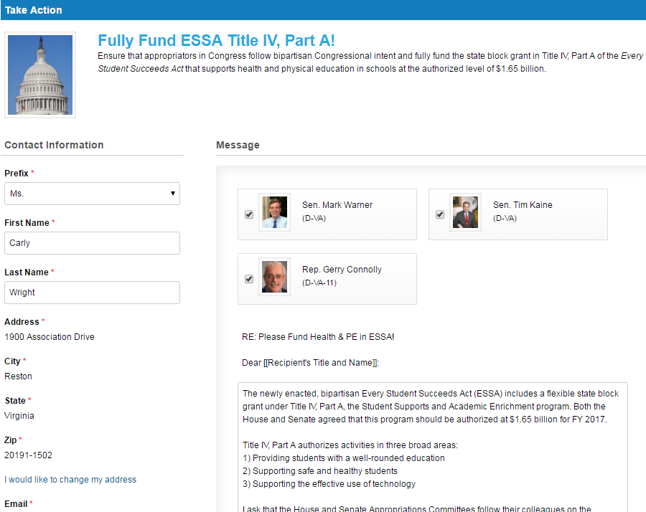
Take Action Now!
Visit the SHAPE America Legislative Action Center at shapeamerica.org/advocacy
to contact your members of Congress to ask for #MoreTitleIV!

Slide 15

Engage Stakeholders
Educators & Parents are required to be included!
Your principal – state principal association
Your superintendent – state superintendents association
State education agency
State board of education
Governor
State school chief
PTA/PTO
State teacher associations
School board

Slide 16

What Can We Do?
Educate yourself on ESSA
Educate others on the opportunities for HPE
Engage in state & school district level discussions & planning on ESSA
Advocate for funding on the federal, state, and local level
Be the positive change agent that your state needs!
CALLING ALL ADVOCATES!

Slide 17
Top 10 Tools for ESSA
1
Getting Started with ESSA – become the expert on ESSA with this free, 20-page e-guide
2
ESSA Fact Sheet – get a concise, one-page overview of the new legislation
3
Title IV, Part A Fact Sheet – learn about this new block grant that includes funding for HPE
4
State Advocacy Toolkit – access customized ESSA tools and contact info for each state
5
ESSA Support Letter – use this template to ask key stakeholders to ensure HPE are included in state/local plans
shapeamerica.org/advocacy

Slide 18
Top 10 Tools for ESSA
6
PE + Health = Student Success – share this infographic of benefits of HPE for students
7
ESSA Videos – watch these videos to understand the impact of ESSA on HPE
8
Title IV, Part A Action Alert – contact Congress to ensure sufficient funding is allocated
9
ESSA Impact on HPE PowerPoint – educate key stakeholders with this presentation
10
Exchange – continue the discussion on SHAPE America’s online community of HPE leaders
shapeamerica.org/advocacy

Slide 19
Contact Me For Any Questions
Heather Bachman
Email: bachman.heather@westada.org

