Slide 1



What factors effect our body composition?
October 2019
McKayla Austin, Mika Rives, Dr. Collin Fehr, Dr. Clay Robinson

Slide 2
Why the focus on body Composition?
Obesity rates are increasing by 1% per year
19% of all children are overweight or obese
Obese individuals health care cost are 6X over the national average
More than 68% of the U.S. population is overweight or obese
Physical activity is decreasing among all age population groups
Caloric intake predictions have not changed in the past twenty years

Slide 3
What is body composition anyway?
Male 170 # Female 140 #
Muscle 43% 73# Muscle 36% 50#
Essential fat 3% 5# Essential fat 12% 17#
Storage fat 14% 24# Storage fat 15% 21#
Bone 15% 26# Bone 12% 17#
Other tissue 25% 43# Other tissue 25% 35#

Slide 4
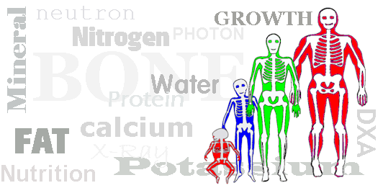
Body composition
Lean body mass LBM or FFM: includes fluids, lean muscle, connective tissue, organs, bones
Fat EFM: essential fat include lipids incorporated in cells of nerves, brains, heart, lungs, liver, and glands 3%men 12% women (ACSM 2014)
Nonessential fat NEFM: storage fat or adipose tissue located just underneath the skin and around major organs (10 to 15% for both genders)

Slide 5
What factors have an effect on body composition?
Activity Level?
Type of activity?
Fuel Mix during exercise?
Resting Metabolic Rate?
Gender √
Caloric Intake√
Genetics √
Health √
Age √

Slide 6
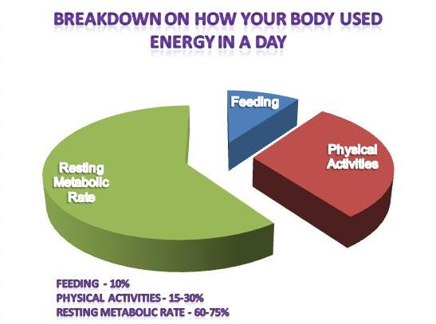
Resting Metabolic Rate 60-75% of our caloric expenditure

Slide 7
Ways to increase or decrease your REE
Exercise (Number one factor to ↑ REE)
Eat small meals and snacks throughout the day
Short burst of activity
Temperature
Stress
Fever
Illness
Muscle
Be a potato
Eat big meals high in fat and skip
meals
Starvation or very low restricted
caloric diet
Moderate temperature
Lower your percentage of lean
body mass

Slide 8
What we do know about training from research.
Research study investigating diffrences between aerobically trained swimmers and anaerobically trained wrestlers resulted in significant differences in VO2 max and anaerobic capacity but not a significant difference in resting metabolic rates.
Schmidt, W., Hyner, G. C., Lyle, R. M., Corrigan, D., Bottoms, G., & Melby, C. L. (1994). The Effects of Aerobic and Anaerobic Exercise Conditioning on Resting Metabolic Rate and the Thermic Effect of a Meal, International Journal of Sport Nutrition, 4(4), 335-346. Retrieved Sep 25, 2019, from https://journals.humankinetics.com/view/journals/ijsnem/4/4/article-p335.xml

Slide 9
ANOVA Between groups based on training and the effect on RMR p=.301
Aerobic

Slide 10
Gender plays a bigger role in RMR p=.0260
No matter what the type of training gender was a more significant factor on RMR than any other factor including body composition, fitness level, fuel mix during activity, and type of training.

Slide 11
Difference in fuel mix at rest by type of training
Aerobically Trained fuel mix average
70% fat and 30% Carbohydrates
Anaerobically trained fuel mix average
50.25 Fat and 49.75 Carbohydrate
Aerobically trained individuals burned more calories from fat at rest than anaerobically trained individuals.
Did this have any influence on Body Composition?

Slide 12
Body Composition Results by gender
Females
T-test between predicted and measure residual volume hydrostatic weighing p=.248
Mean of predicted=21.17
Mean for measured=23.1225
The population group were all fit individuals who had less residual volume than the average population group
Single factor ANOVA p=.5904

Slide 13
Body Composition for the males
Both population groups
very healthy. Single Factor ANOVA p=.6425

Slide 14
Brain Break: what have we learned so far?
So far gender is the most significant variable in differences in RMR
The study includes healthy individuals
Fuel mix at rest does not have a big effect on RMR.
Type of activity that one participates in training is not a big factor in differences in RMR

Slide 15
What about Fuel used during activity?
Who do we expect to cross over to using more carbohydrates at an earlier state in a graded exercise test aerobically trained or anaerobically trained individuals? P=.69134

Slide 16
What we are finding is differences in hear rates.
Not only what their heart rates are at the cross over point but also what percentage of their predicted maximum heart rate they are working at when they cross over.
Heart rate Cross over average ANVOA p=.02766
Percentage of maximum Heart rate at cross over point.

Slide 20
Thank You. Questions?

